Slide 1
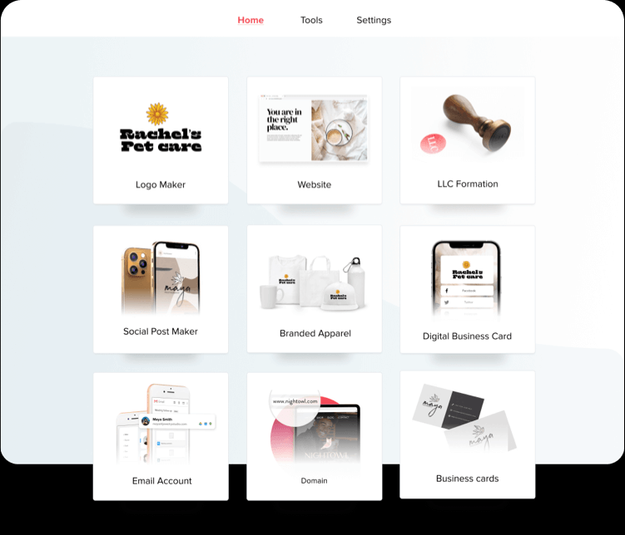
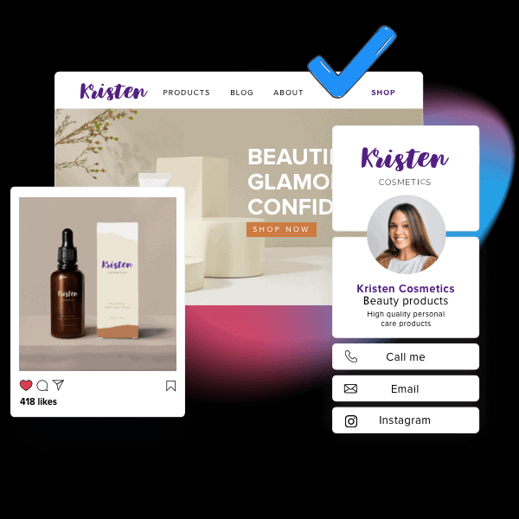
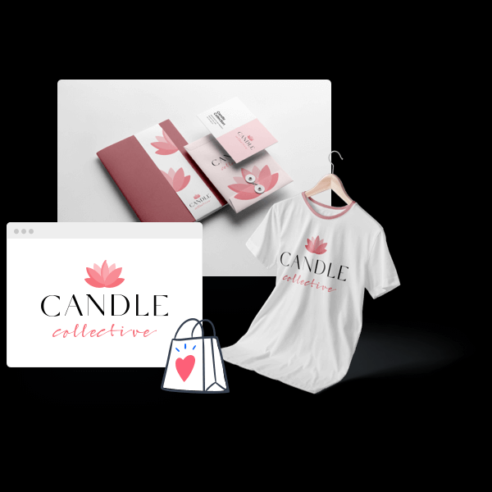
Launch your business in just a few clicks
All the tools you need to start your business and look professional, in one place
Get your LLC
Sleep easy at night
knowing that your
business and its assets
are protected.
We make it
simple to register your business as an LLC and trademark your logo
* This service is only available in the US
Tailor Brands (logo maker page)
TailorBrands HomePage PT Brasi
Tailor Brands Home Page French
Tailor Brands Home Page Spanish
Put your brand
out there
Show up as a pro
with printed business cards, t-shirts and branded merchandise that make your brand look official from day one.
Tailor Brands Home Page Italian
Tailor Brands Home Page Deutsch
TailorBrands HomePage English
A true
one-stop-shop
Use our AI-powered tool to create a logo and style guide that’s the perfect match for your business. Get unlimited designs for social media and publish your digital business card, all branded with your logo and theme.

