Slide 1
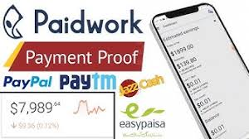
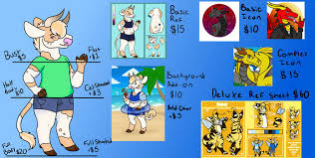
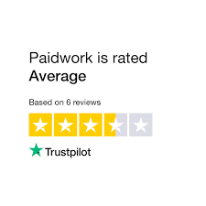
SINCE 17.08.2022
Play games
Salary:
0.95 - €95.00
for completing a task in a game
BACK
What do I need to do?
You need to install the game you like and complete a specific task in the game, for example: "Reach a certain character level or unlock a feature". Some tasks take several days to complete. The more difficult the task, the more you earn.
Fill out surveys
Salary:
0.48 - €9.50
for each completed survey
BACK
What do I need to do?
You need to complete surveys based on your interests, for example: "District survey about care of domestic animals in your home". This method of earning requires spending more time and possibly providing personal data.
Watch videos
Salary:
0.1 - 1 Points
for watching a video
BACK
What do I need to do?
You need to watch 30-second video ads. After clicking "Start watching videos", a new video will appear. After 30 seconds you will be paid for watching the video. If you close an ad or window during monetization, you won't earn.
Online shopping
Salary:
0.48 - €23.75
for purchasing a product
BACK
What do I need to do?
You need to buy various products and participate in free trials. The amount you will get bac
on the value of the product purchased. To make the purchase correctly, follow the steps.
+371 29196580
paidwork@mail.lv
https://veliks.weebly.com/

